Slide 1


Analysis on Content creation for Social Buzz

Slide 2


Today's agenda
Project recap
Problem
The Analytics team
Process
Insights
Summary

Slide 3

Social Buzz is one of the content creators emphasizes content by keeping all users anonymous, only tracking user reactions on every piece of content. Now they want to track on big data in order to have,
an IPO by the end of next year and need guidance to ensure that this goes smoothly.
They are still a small company and do not have the resources to manage the scale that they are currently at. They could hire more people, but they want an experienced practice to help instead.
They want to learn data best practices from a large corporation. Due to the nature of their business, they have a massive amount of data so they are keen on understanding how the world's biggest companies manage the challenges of big data.
Project Recap

Slide 4


successful IPO (Initial Public Offering)
An audit of their big data practice
An analysis of their content categories that highlights the top 5 categories with the largest aggregate popularity
Problem

Slide 5



Andrew Fleming (Chief Technical Architect)
The Analytics team
Marcus Rompton
(Senior Principle)
Anusha
(Data Analyst)

Slide 6
Process
1
Understanding the business needs/requirement
2
Extracting /Collecting required data from sources
3
Cleaning data with necessary steps for EDA
4
Analysis of sample data sets with visualizations
5
Full documentation of the process that we can guide them through for IPO

Slide 7

Insights
16
Unique categories
1897 reactions popular category
January month with the most posts

Slide 8
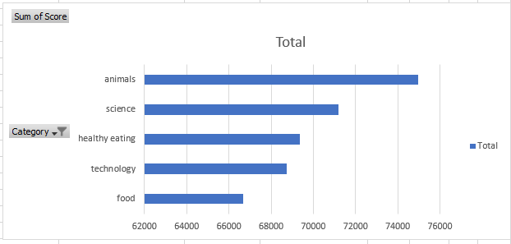
Top 5 content categories.

Slide 10

As per the Analysis on the data , it was found that ,
We have 16 unique categories out of which Animal Category have the highest popularity when compared with score with mixed reaction types
For the month of Jan have the highest rate of posting .
Top 5 categories have the almost equal distribution over the content score.
Summary

Slide 11

Thank you!
ANY QUESTIONS?

